Slide 1
Manual (not Tecplot) cell connections
Meeting May 27, 2025

Slide 2
Abdul problem mesh-centred outflow results
Next 2 slides compare the results before and after code modification

Slide 3
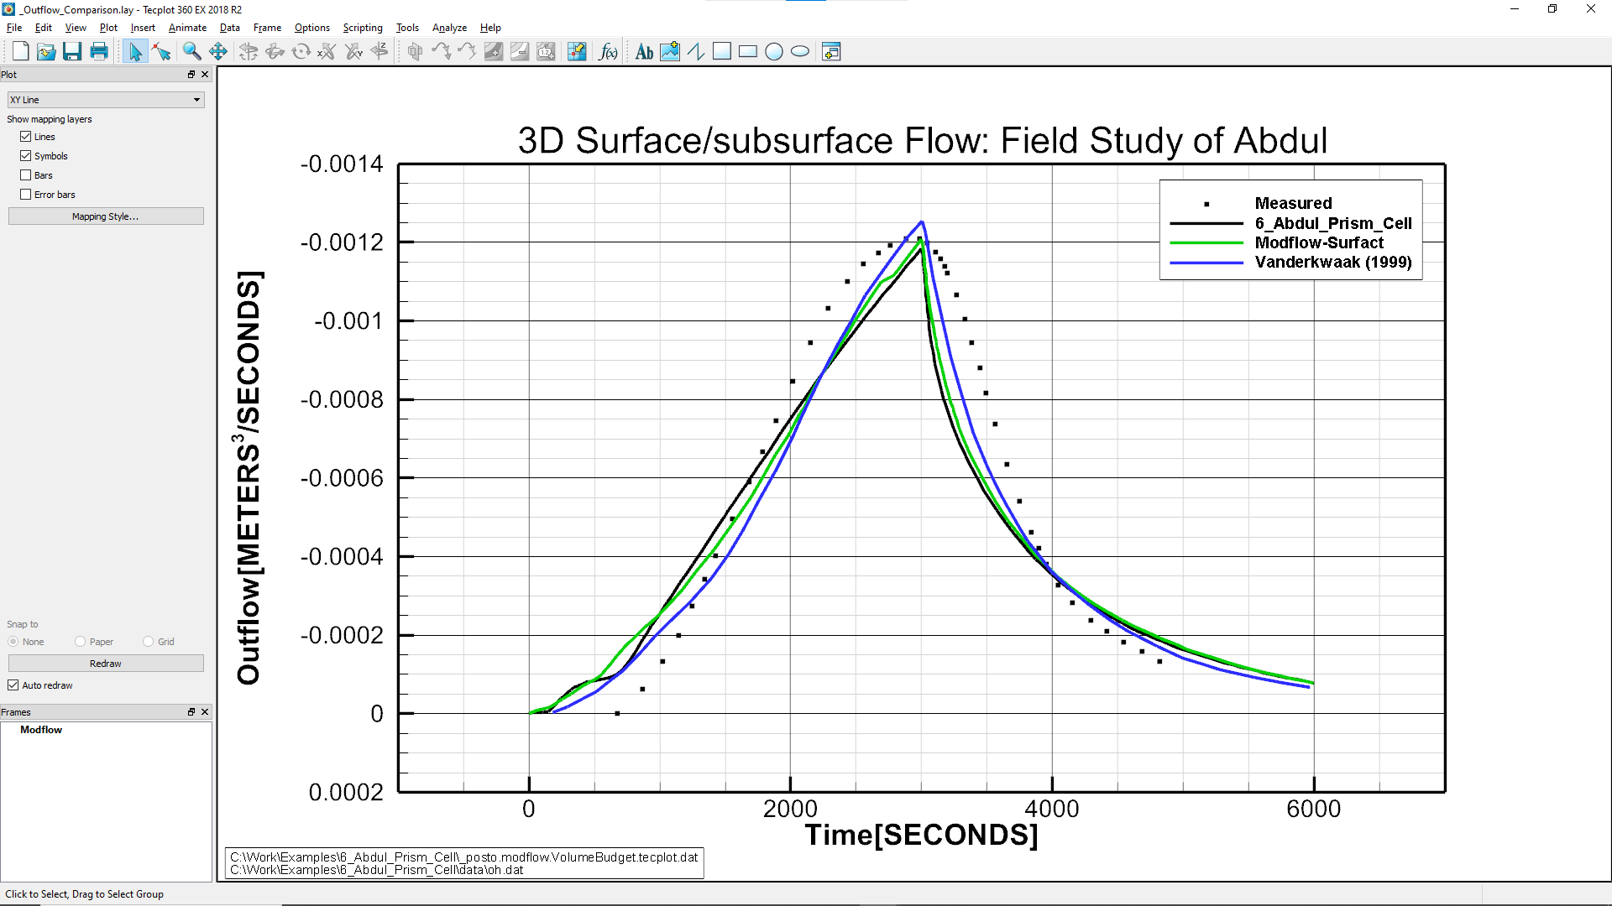
Modflow-User-Tools version 1.40 Beta

Slide 4

Modflow-User-Tools version 1.42 faces

Slide 5
Abdul problem node-centred outflow results
Next 2 slides compare the results before and after code modification

Slide 6

Modflow-User-Tools version 1.40 Beta

Slide 7
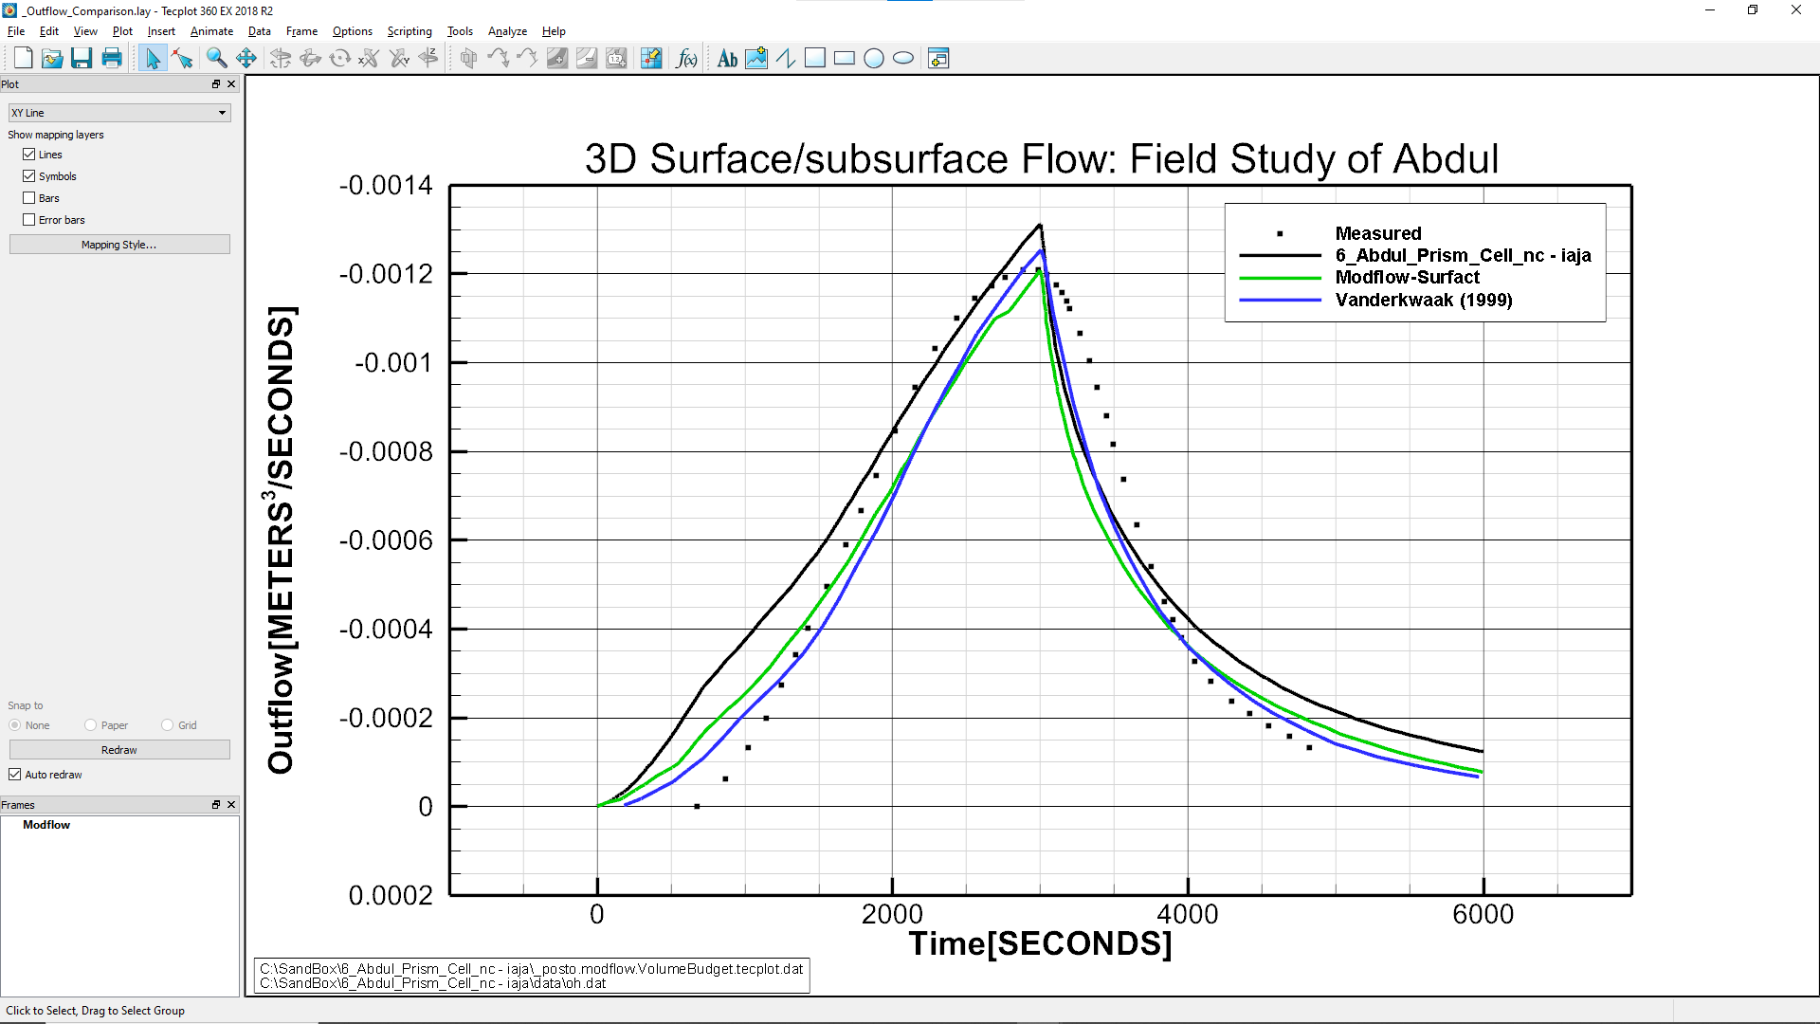
Modflow-User-Tools version 1.42 faces

Slide 8
8_V_catchment problem outflow results with latest version Modflow-User-Tools version 1.42 faces
Next 2 slides compare the results for mesh vs node-centred approaches

Slide 9
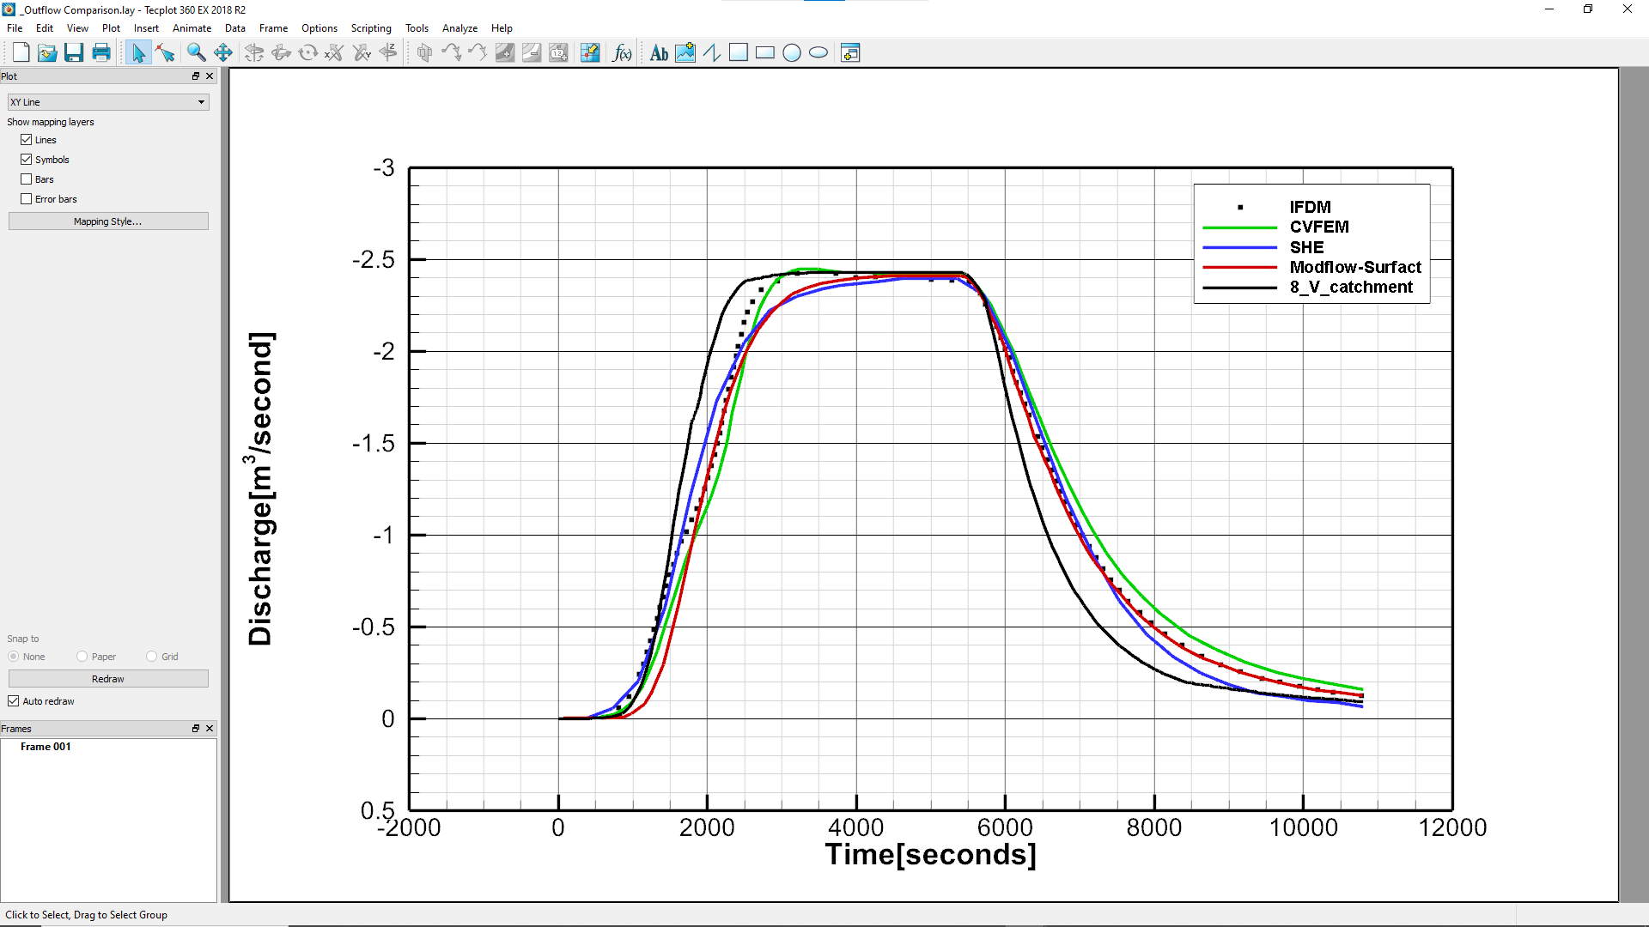
Mesh-centred

Slide 10
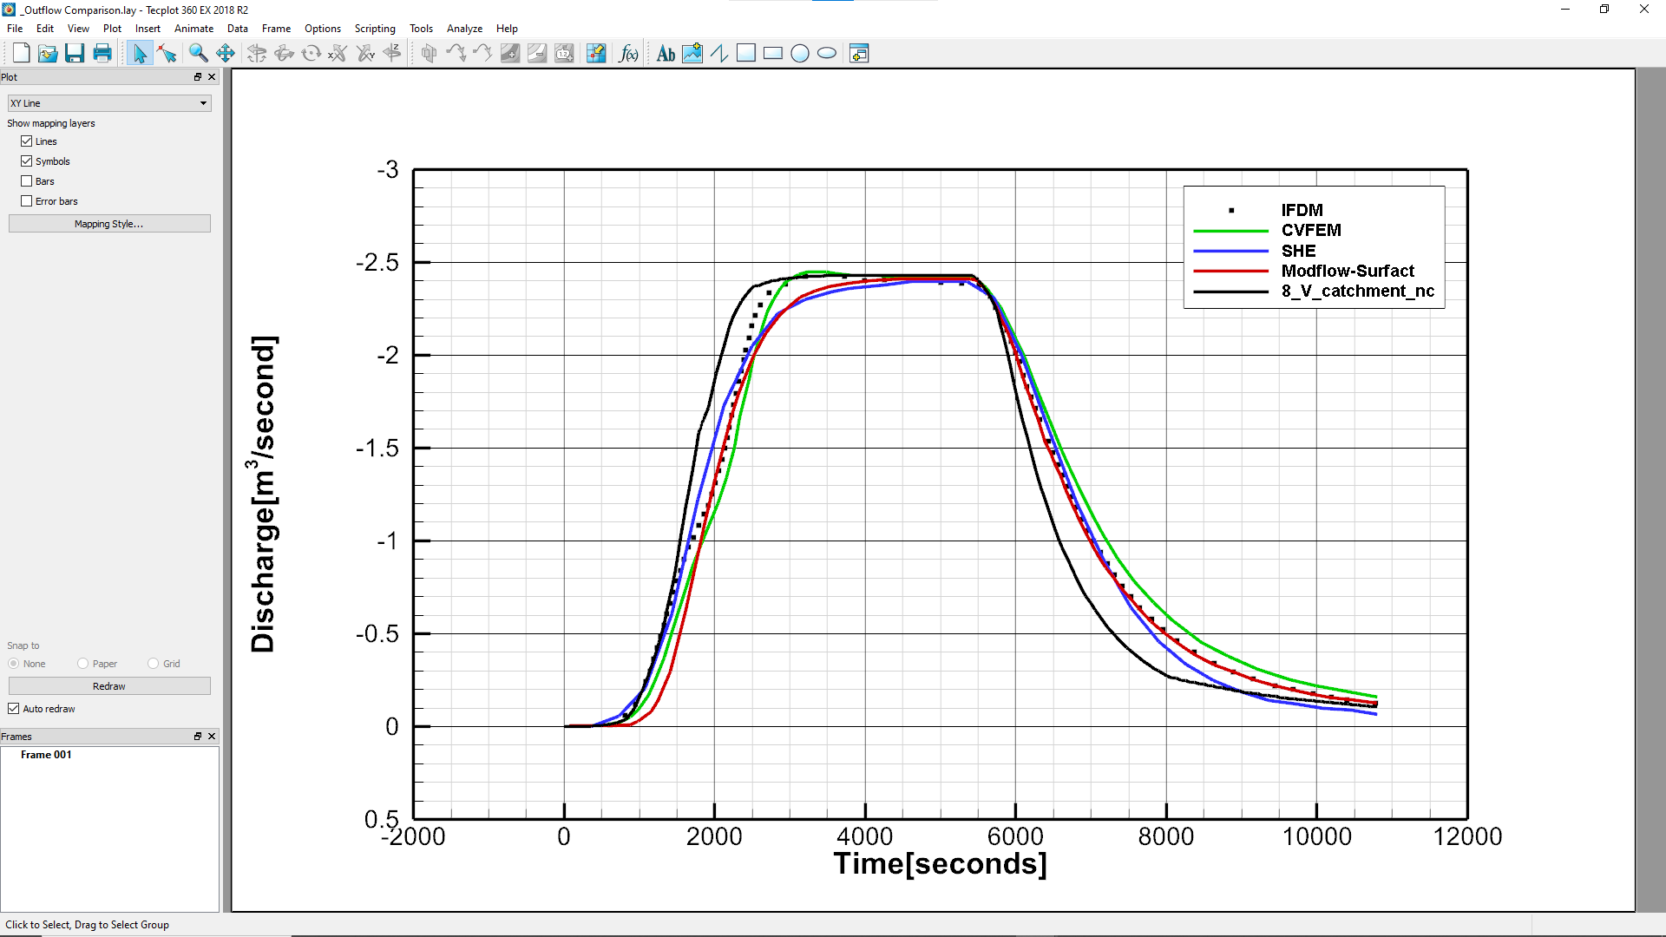
Node-centred

Slide 11
7_SuperSlab problem results with latest version Modflow-User-Tools version 1.42 faces
Next slides shows saturation at 4 hours

Slide 12
